Slide 1
PROJECT :
FARM PLUS
TEAM NAME : WEB ENTHUSIASTIC
TEAM LEADER : ROHIT KUMAR (ML & DATA ANALYZER)
TEAM MEMBER: SHIVENDRA PRATAP SINGH (WEB DEVELOPMENT & DATABASE)
TEAM MEMBER: MOHIT NAYAN SINGH (ML & MODEL MANAGEMENT)
TEAM MEMBER : RAJESH KUMAR (ML & MODEL MANAGEMENT)

Slide 2
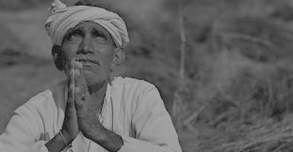
THEME
FOOD
MISSION
HELPING THE BIHAR FARMERS THROUGH ML MODEL BY SUGGESTING THEM THE BEST SUITABLE MONTH & AREA FOR CULTIVATING SPECIFIC CASH CROPS & THEIR FARMING METHODS AND MODERN FARMING METHODS.
MACHINE
LEARNING
TRACK
WEB
DEVELOPMENT

Slide 3
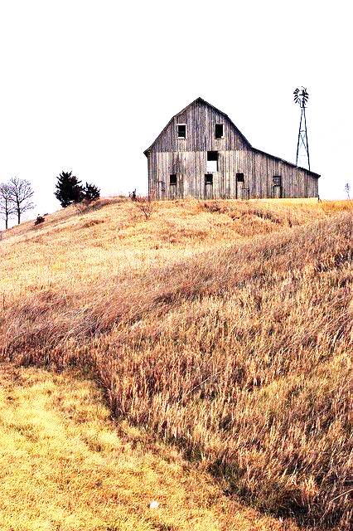
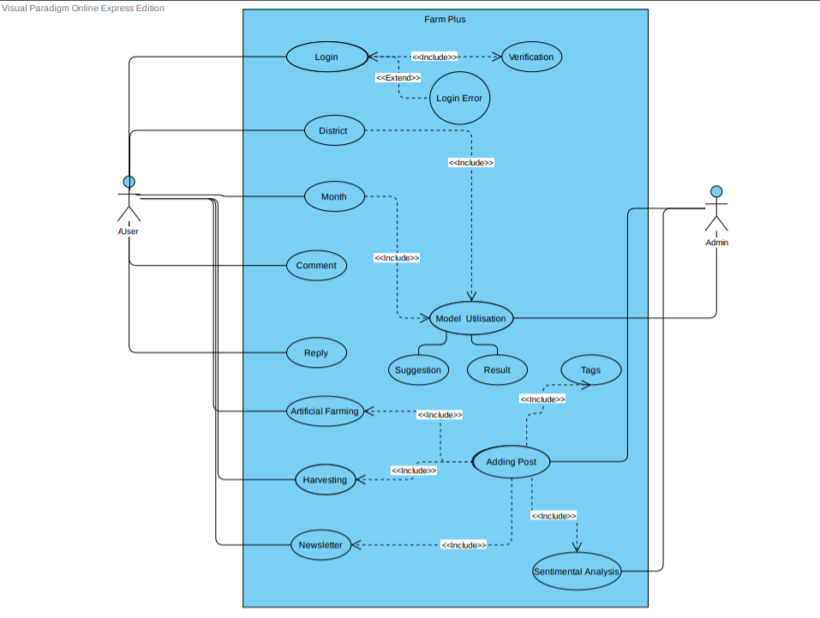
USE CASE

Slide 4
MACHINE LEARNING: DATA FRAMING & ALGORITHM
.
ALGORITHMS USED IN MODEL:
DECISION TREE CLASSIFIER
RANDOM FOREST CLASSIFIER
TEMPERATURE
RELATIVE HUMIDITY
MEAN RAINFALL
AVG. NUMBER OF RAINY DAY
CLOUD
MONTHLY_DATA.csv
After
Modifica-
tion
Day wise Data
1year Weather data of 14 district of Bihar

Slide 5
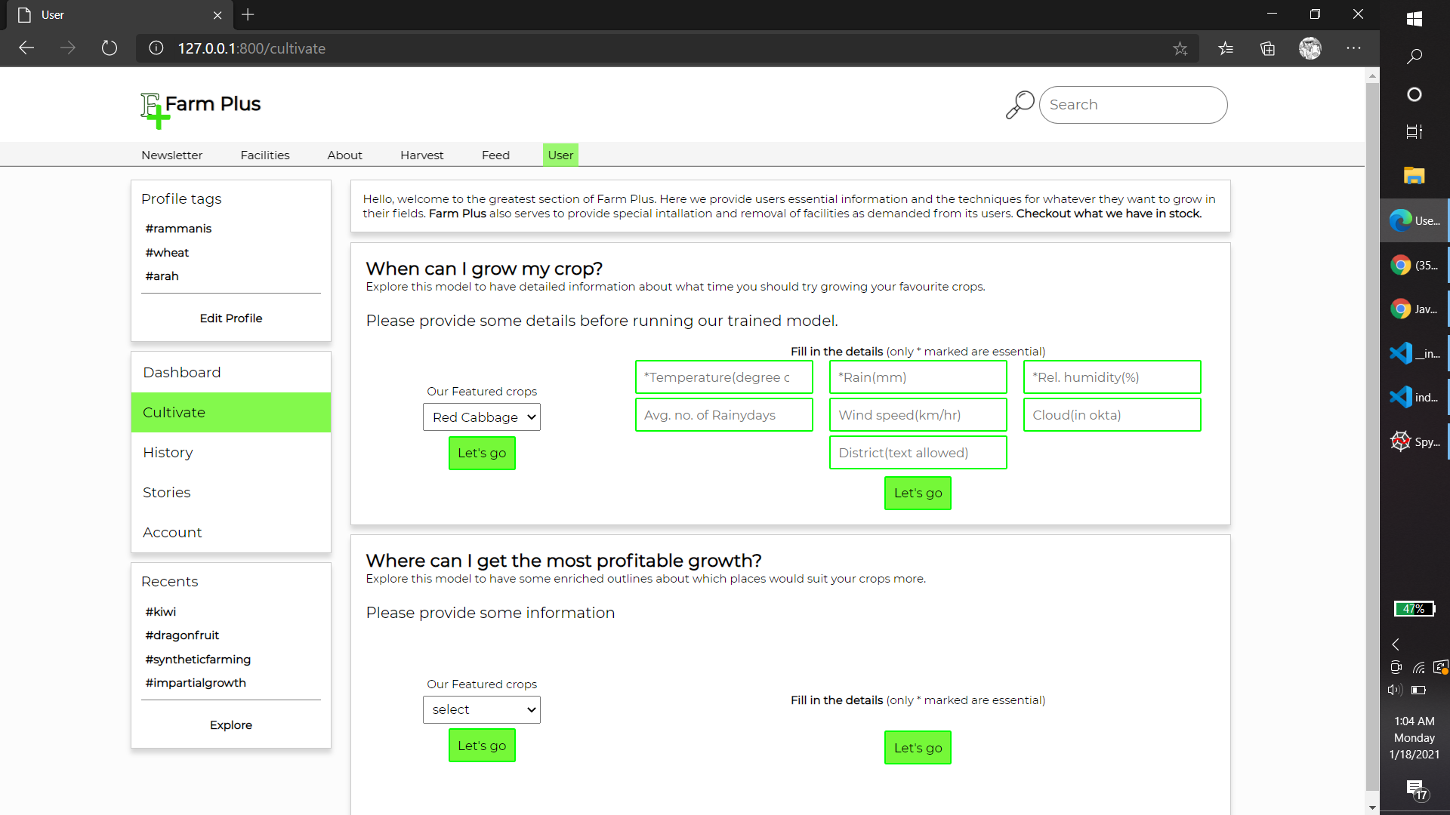
INPUT :REGARDING MONTH PREDICTION

Slide 6
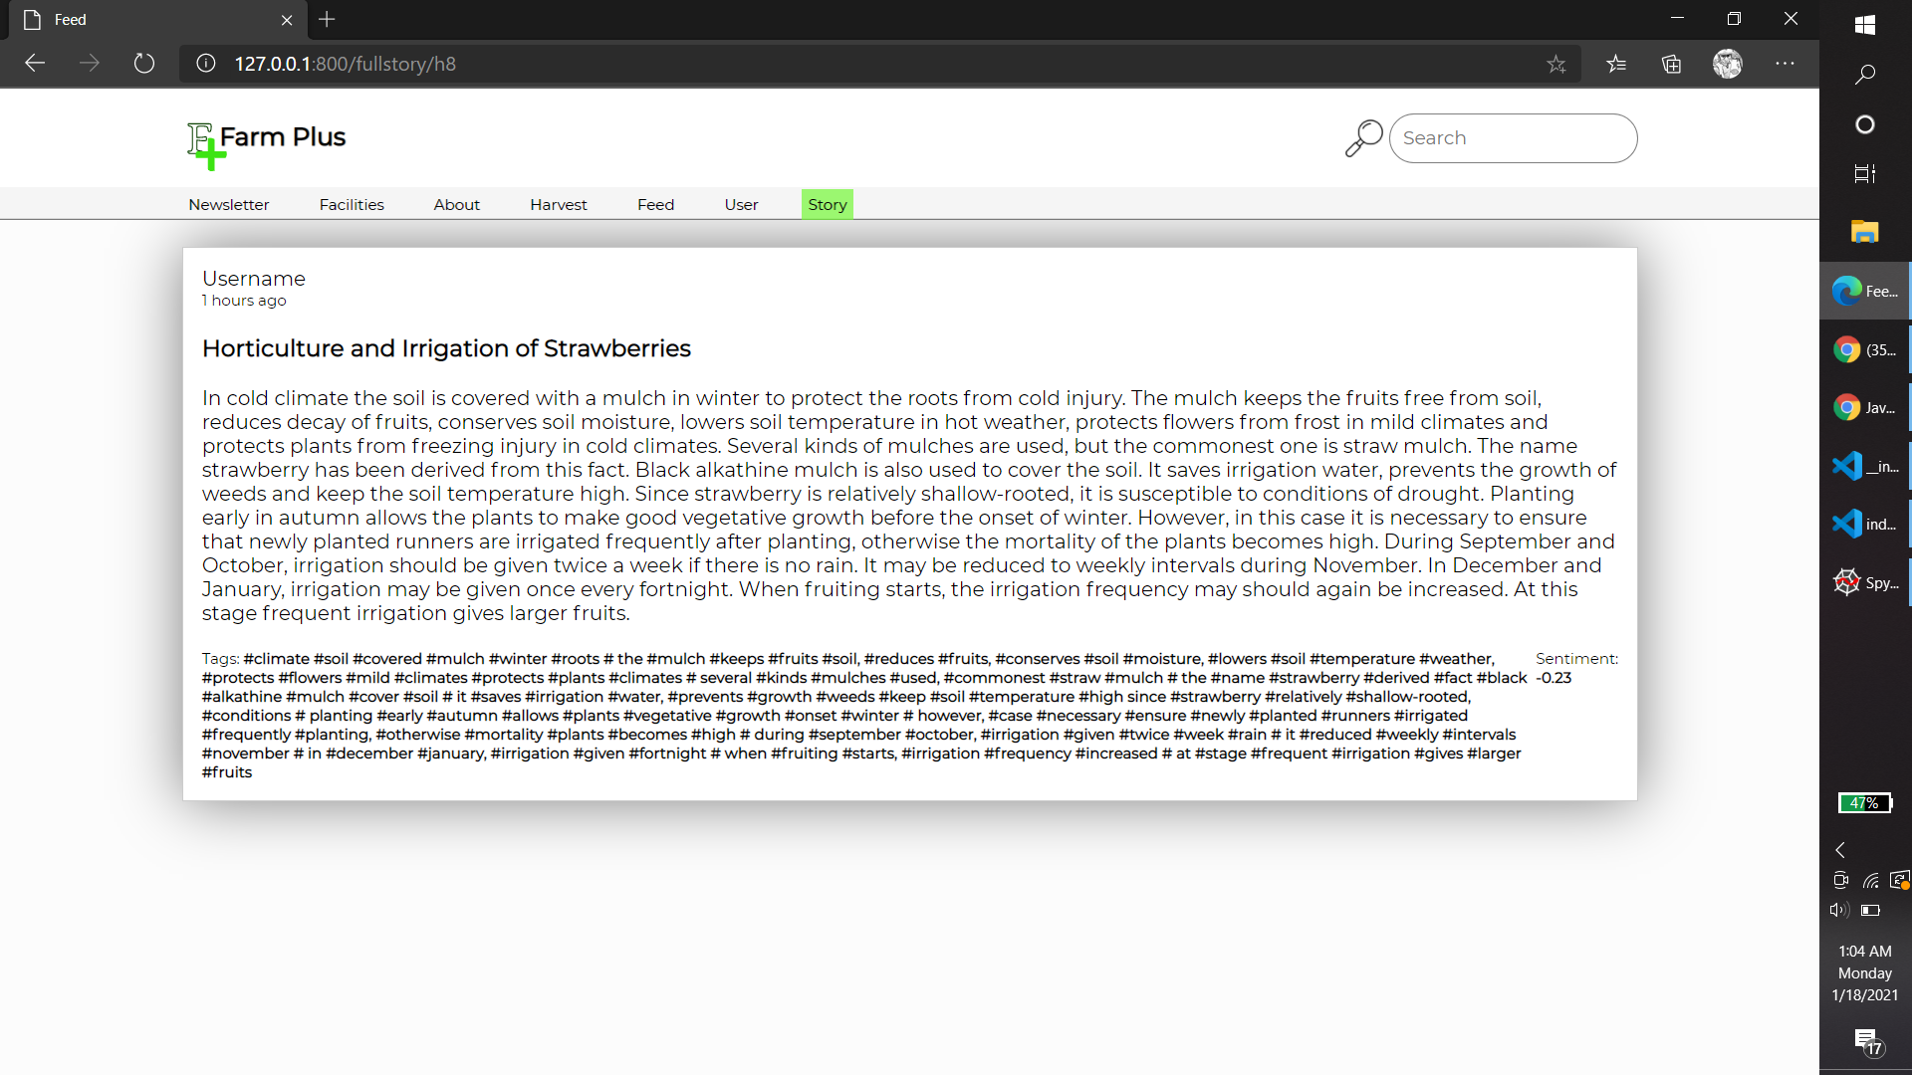
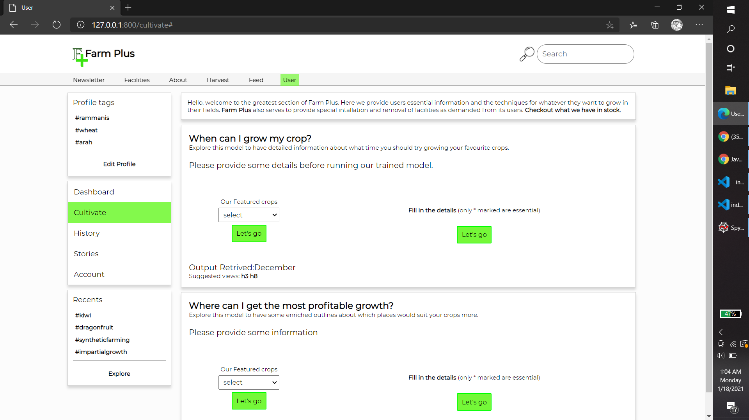
OUTPUT & SUGGESTION :REGARDING MONTH PREDICTION
Redirect to article h8 after mouse click
Output+Suggestion(h3 and h8)

Slide 7
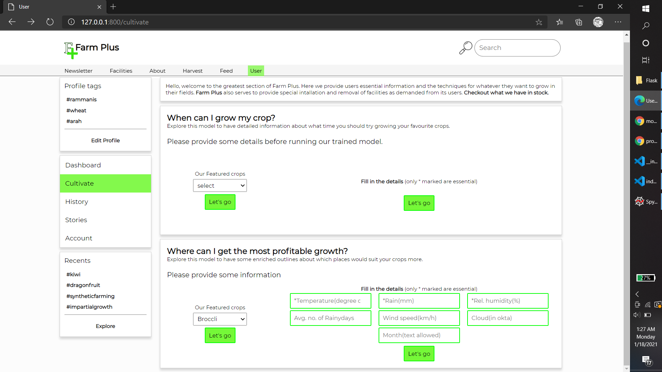
INPUT :REGARDING DISTRICT PREDICTION
Two fields to provide Input (One with featured luxury crops)

Slide 8
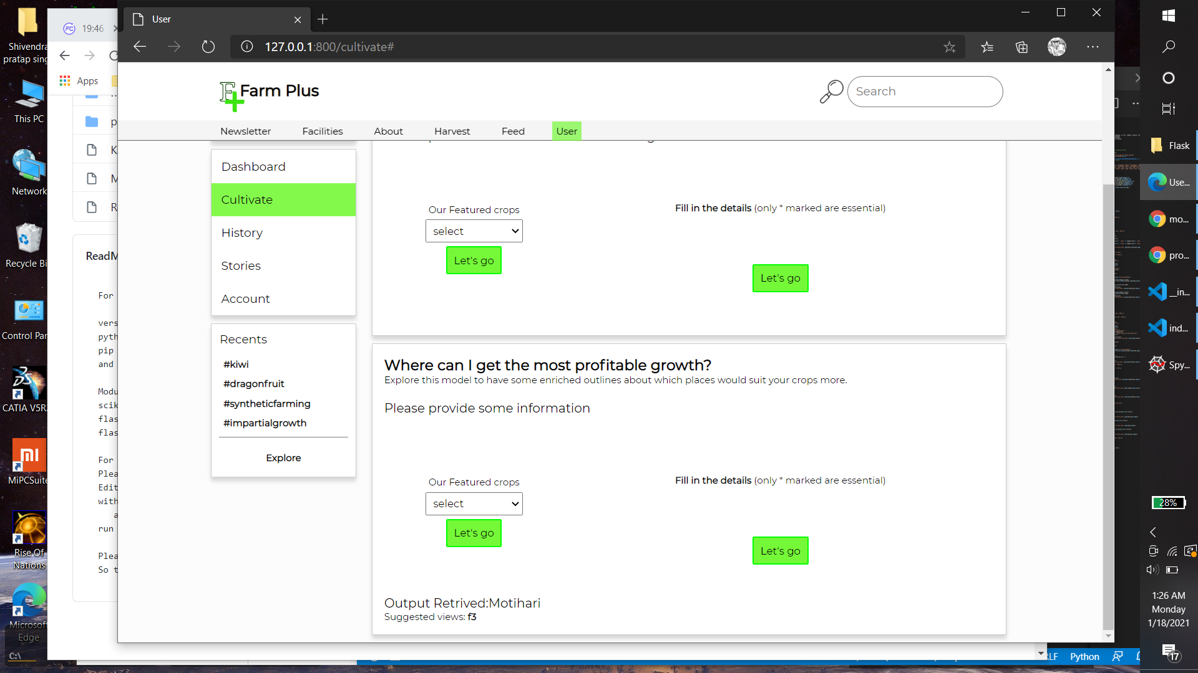
OUTPUT :REGARDING DISTRICT PREDICTION
Output with suggested article as provided by admin

Slide 9
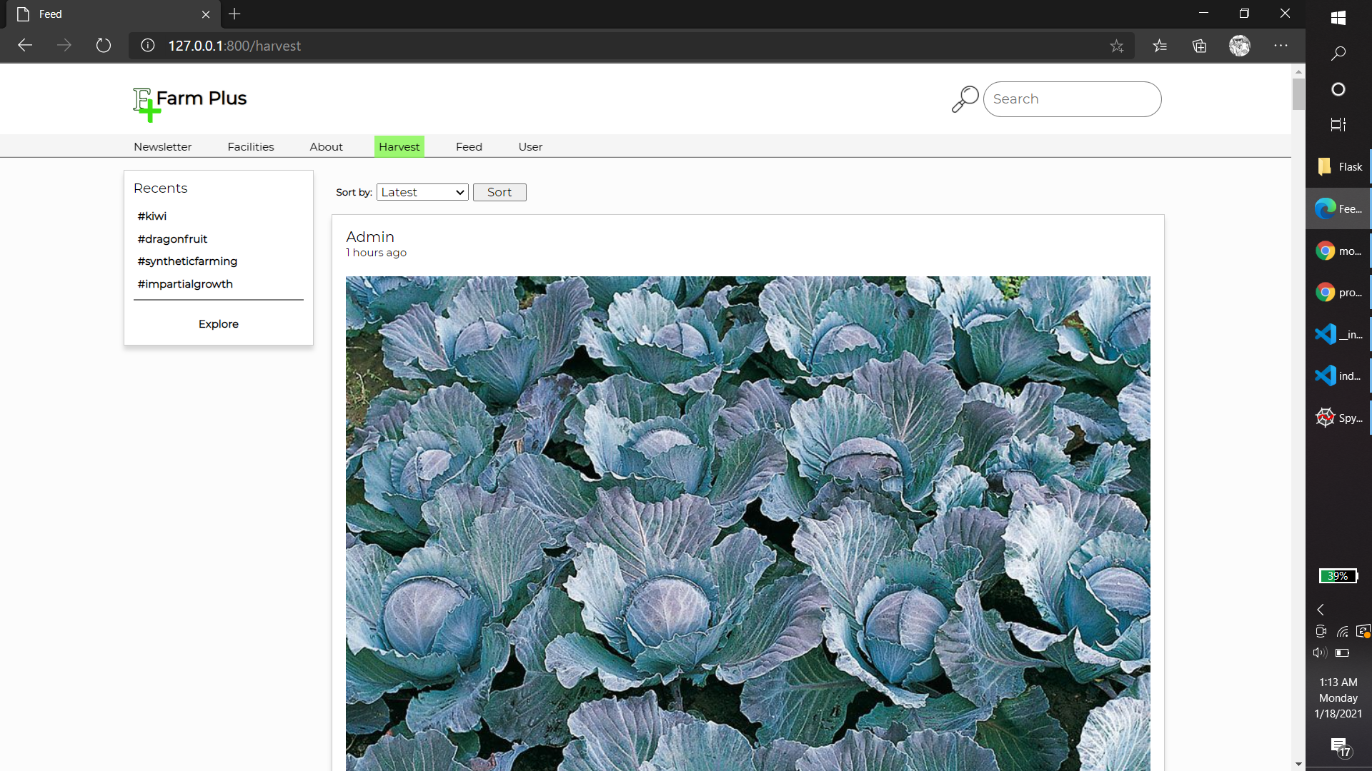
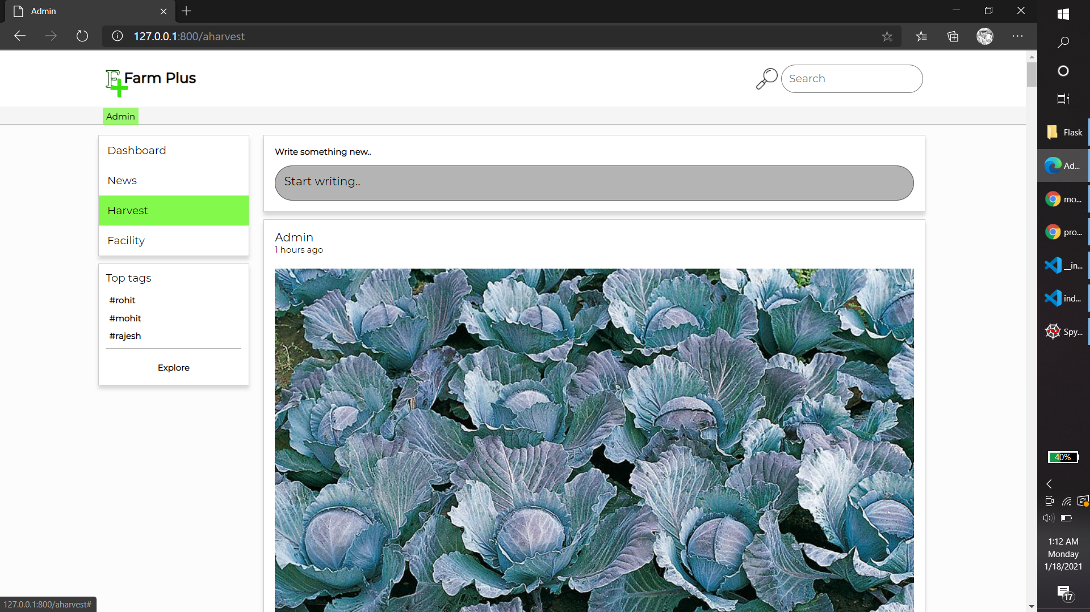
Admin Access to App Content
Edit option to admin
User View for same content

